Slide 1
RED BLACK TREES

Slide 2
Red-Black TREE
WHY red-black tree?
Most of the BST operations (e.g., search, max, min, insert, delete.. etc) take O(h) time where h is the height of the BST. The cost of these operations may become O(n) for a skewed Binary tree.
If we make sure that the height of the tree remains O(log n) after every insertion and deletion, then we can guarantee an upper bound of O(log n) for all these operations.
The height of a Red-Black tree is always O(log n) where n is the number of nodes in the tree.
“n” is the total number of elements in the red-black tree.

Slide 3
Red-Black Properties
The red-black properties:
1. Every node is either red or black
2. Every leaf (NULL pointer) is black
Note: this means every “real” node has 2 children
3. If a node is red, both children are black
Note: can’t have 2 consecutive reds on a path
4. Every path from node to descendent leaf contains the same number of black nodes
5. The root is always black

Slide 4
Red-Black Trees
Put example on board and verify properties:
1. Every node is either red or black
2. Every leaf (NULL pointer) is black
3. If a node is red, both children are black
4. Every path from node to descendent leaf contains the same number of black nodes
5. The root is always black
black-height: # black nodes on path to leaf
Black Height of a Red-Black Tree :
Black height is the number of black nodes on a path from the root to a leaf. Leaf nodes are also counted black nodes.
Red-Black Tree of height h has black-height >= h/2.
Label example with h and bh values

Slide 5
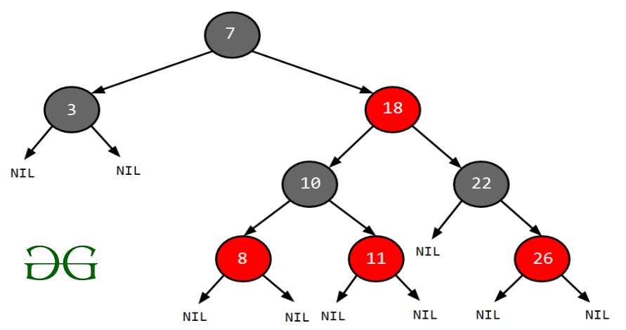
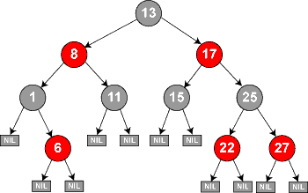
Red-Black Trees

Slide 6
Height of Red-Black Trees
What is the minimum black-height of a node with height h?
A: a height-h node has black-height ≥ h/2
Theorem: A red-black tree with n internal nodes has height h ≤ 2 lg(n + 1)
How do you suppose we’ll prove this?

Slide 7
RB Trees: Proving Height Bound
Prove: n-node RB tree has height h ≤ 2 lg(n+1)
Claim: A subtree rooted at a node x contains at least 2^{bh(x)} - 1 internal nodes
Proof by induction on height h
Base step: x has height 0 (i.e., NULL leaf node)
What is bh(x)?

Slide 8
RB Trees: Proving Height Bound
Prove: n-node RB tree has height h ≤ 2 lg(n+1)
Claim: A subtree rooted at a node x contains at least 2^{bh(x)} - 1 internal nodes
Proof by induction on height h
Base step: x has height 0 (i.e., NULL leaf node)
What is bh(x)?
A: 0
So…subtree contains 2^{bh(x)} - 1 = 2⁰ - 1 = 0 internal nodes (TRUE)

Slide 9
RB Trees: Proving Height Bound
Inductive proof that subtree at node x contains at least 2^{bh(x)} - 1 internal nodes
Inductive step: x has positive height and 2 children
Each child has black-height of bh(x) or bh(x)-1 (Why?)
The height of a child = (height of x) - 1
So the subtrees rooted at each child contain at least 2^{bh(x) - 1} - 1 internal nodes
Thus subtree at x contains (2^{bh(x) - 1} - 1) + (2^{bh(x) - 1} - 1) + 1 = 2•2^{bh(x)-1} - 1 = 2^{bh(x)} - 1 nodes

Slide 10
RB Trees: Proving Height Bound
Thus at the root of the red-black tree:
n ≥ 2^{bh(root)} - 1 (Why?)
n ≥ 2^{h/2} - 1 (Why?)
lg(n+1) ≥ h/2 (Why?)
h ≤ 2 lg(n + 1) (Why?)
Thus h = O(lg n)

Slide 11
RB Trees: Worst-Case Time
So we’ve proved that a red-black tree has O(lg n) height
Corollary: These operations take O(lg n) time:
Minimum(), Maximum()
Successor(), Predecessor()
Search()
Insert() and Delete():
Will also take O(lg n) time
But will need special care since they modify tree

Slide 12
Red-Black Trees: An Example
Color this tree:
7
7
5
5
9
9
12
12
Red-black properties:
1. Every node is either red or black
2. Every leaf (NULL pointer) is black
3. If a node is red, both children are black
4. Every path from node to descendent leaf contains the same number of black nodes
5. The root is always black

Slide 13
Red-Black Trees: The Problem With Insertion
Insert 8
Where does it go?
7
5
9
12
1. Every node is either red or black
2. Every leaf (NULL pointer) is black
3. If a node is red, both children are black
4. Every path from node to descendent leaf contains the same number of black nodes
5. The root is always black

Slide 14
Red-Black Trees: The Problem With Insertion
Insert 8
Where does it go?
What color should it be?
7
5
9
8
12
1. Every node is either red or black
2. Every leaf (NULL pointer) is black
3. If a node is red, both children are black
4. Every path from node to descendent leaf contains the same number of black nodes
5. The root is always black

Slide 15
Red-Black Trees: The Problem With Insertion
Insert 8
Where does it go?
What color should it be?
7
5
9
8
12
1. Every node is either red or black
2. Every leaf (NULL pointer) is black
3. If a node is red, both children are black
4. Every path from node to descendent leaf contains the same number of black nodes
5. The root is always black

Slide 16
Red-Black Trees: The Problem With Insertion
Insert 11
Where does it go?
7
5
9
8
12
1. Every node is either red or black
2. Every leaf (NULL pointer) is black
3. If a node is red, both children are black
4. Every path from node to descendent leaf contains the same number of black nodes
5. The root is always black

Slide 17
Red-Black Trees: The Problem With Insertion
Insert 11
Where does it go?
What color?
7
5
9
8
12
11
1. Every node is either red or black
2. Every leaf (NULL pointer) is black
3. If a node is red, both children are black
4. Every path from node to descendent leaf contains the same number of black nodes
5. The root is always black

Slide 18
Red-Black Trees: The Problem With Insertion
Insert 11
Where does it go?
What color?
Can’t be red! (#3)
7
5
9
8
12
11
1. Every node is either red or black
2. Every leaf (NULL pointer) is black
3. If a node is red, both children are black
4. Every path from node to descendent leaf contains the same number of black nodes
5. The root is always black

Slide 19
Red-Black Trees: The Problem With Insertion
Insert 11
Where does it go?
What color?
Can’t be red! (#3)
Can’t be black! (#4)
7
5
9
8
12
11
1. Every node is either red or black
2. Every leaf (NULL pointer) is black
3. If a node is red, both children are black
4. Every path from node to descendent leaf contains the same number of black nodes
5. The root is always black

Slide 20
Red-Black Trees: The Problem With Insertion
Insert 11
Where does it go?
What color?
Solution: recolor the tree
7
5
9
8
12
11
1. Every node is either red or black
2. Every leaf (NULL pointer) is black
3. If a node is red, both children are black
4. Every path from node to descendent leaf contains the same number of black nodes
5. The root is always black

Slide 21
Red-Black Trees: The Problem With Insertion
Insert 10
Where does it go?
7
5
9
8
12
11
1. Every node is either red or black
2. Every leaf (NULL pointer) is black
3. If a node is red, both children are black
4. Every path from node to descendent leaf contains the same number of black nodes
5. The root is always black

Slide 22
Red-Black Trees: The Problem With Insertion
Insert 10
Where does it go?
What color?
7
5
9
8
12
11
1. Every node is either red or black
2. Every leaf (NULL pointer) is black
3. If a node is red, both children are black
4. Every path from node to descendent leaf contains the same number of black nodes
5. The root is always black
10

Slide 23
Red-Black Trees: The Problem With Insertion
Insert 10
Where does it go?
What color?
A: no color! Tree is too imbalanced
Must change tree structure to allow recoloring
Goal: restructure tree in O(lg n) time
7
5
9
8
12
11
10

Slide 24
RB Trees: Rotation
Our basic operation for changing tree structure is called rotation:
Does rotation preserve inorder key ordering?
What would the code for rightRotate() actually do?
y
x
rightRotate(y)
x
C
A
y
leftRotate(x)
A
B
B
C

Slide 25
RB Trees: Rotation
Answer: A lot of pointer manipulation
x keeps its left child
y keeps its right child
x’s right child becomes y’s left child
x’s and y’s parents change
What is the running time?
y
x
rightRotate(y)
x
C
A
y
A
B
B
C

Slide 26
Rotation Example
Rotate left about 9:
7
5
9
8
12
11

Slide 27
Rotation Example
Rotate left about 9:
7
5
12
9
8
11

Slide 28
Red-Black Trees: Insertion
Insertion: the basic idea
Insert x into tree, color x red
Only r-b property 3 might be violated (if p[x] red)
If so, move violation up tree until a place is found where it can be fixed
Total time will be O(lg n)

Slide 29
rbInsert(x)
treeInsert(x);
x->color = RED;
// Move violation of #3 up tree, maintaining #4 as invariant:
while (x!=root && x->p->color == RED)
if (x->p == x->p->p->left)
y = x->p->p->right;
if (y->color == RED)
x->p->color = BLACK;
y->color = BLACK;
x->p->p->color = RED;
x = x->p->p;
else // y->color == BLACK
if (x == x->p->right)
x = x->p;
leftRotate(x);
x->p->color = BLACK;
x->p->p->color = RED;
rightRotate(x->p->p);
else // x->p == x->p->p->right
(same as above, but with
“right” & “left” exchanged)
Case 1
Case 2
Case 3

Slide 30
rbInsert(x)
treeInsert(x);
x->color = RED;
// Move violation of #3 up tree, maintaining #4 as invariant:
while (x!=root && x->p->color == RED)
if (x->p == x->p->p->left)
y = x->p->p->right;
if (y->color == RED)
x->p->color = BLACK;
y->color = BLACK;
x->p->p->color = RED;
x = x->p->p;
else // y->color == BLACK
if (x == x->p->right)
x = x->p;
leftRotate(x);
x->p->color = BLACK;
x->p->p->color = RED;
rightRotate(x->p->p);
else // x->p == x->p->p->right
(same as above, but with
“right” & “left” exchanged)
Case 1: uncle is RED
Case 2
Case 3

Slide 31
RB Insert: Case 1
Case 1: “uncle” is red
In figures below, all Δ’s are equal-black-height subtrees
if (y->color == RED)
x->p->color = BLACK;
y->color = BLACK;
x->p->p->color = RED;
x = x->p->p;
C
C
new x
case 1
A
D
y
A
D
Δ
B
x
Δ
Δ
Δ
B
Δ
Δ
Δ
Δ
Δ
Δ
Change colors of some nodes, preserving #4: all downward paths have equal b.h.
The while loop now continues with x’s grandparent as the new x

Slide 32
RB Insert: Case 1
Case 1: “uncle” is red
In figures below, all Δ’s are equal-black-height subtrees
if (y->color == RED)
x->p->color = BLACK;
y->color = BLACK;
x->p->p->color = RED;
x = x->p->p;
C
C
new x
case 1
A
D
y
A
D
B
x
Δ
Δ
Δ
B
x
Δ
Δ
Δ
Δ
Δ
Δ
Δ
Same action whether x is a left or a right child

Slide 33
RB Insert: Case 2
Case 2:
“Uncle” is black
Node x is a right child
Transform to case 3 via a left-rotation
if (x == x->p->right)
x = x->p;
leftRotate(x);
// continue with case 3 code
C
C
case 2
A
Δ
y
B
Δ
y
Δ
B
x
A
x
Δ
Δ
Δ
Δ
Δ
Transform case 2 into case 3 (x is left child) with a left rotation
This preserves property 4: all downward paths contain same number of black nodes

Slide 34
RB Insert: Case 3
Case 3:
“Uncle” is black
Node x is a left child
Change colors; rotate right
x->p->color = BLACK;
x->p->p->color = RED;
rightRotate(x->p->p);
C
B
case 3
B
Δ
y
x
A
C
A
x
Δ
Δ
Δ
Δ
Δ
Δ
Δ
Perform some color changes and do a right rotation
Again, preserves property 4: all downward paths contain same number of black nodes

Slide 35
RB Insert: Cases 4-6
Cases 1-3 hold if x’s parent is a left child
If x’s parent is a right child, cases 4-6 are symmetric (swap left for right)

Slide 36
Red-Black Trees: Deletion
And you thought insertion was tricky…
We will not cover RB delete in class
You should read section 14.4 on your own
Read for the overall picture, not the details

